Slide 1
Food Insecurity in
Texas Counties
Jaehwan Han

Slide 2
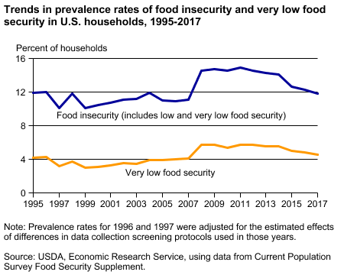
Food insecurity: a household-level economic and social condition of limited or uncertain access to adequate food to support an active, healthy life for all household members.

Slide 3
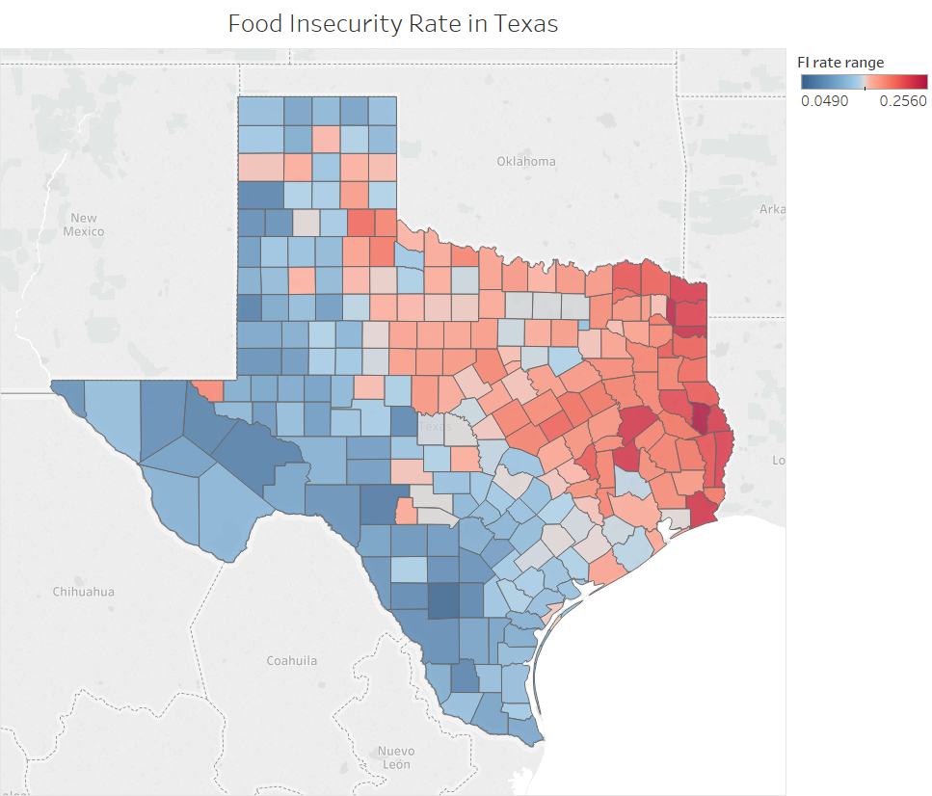
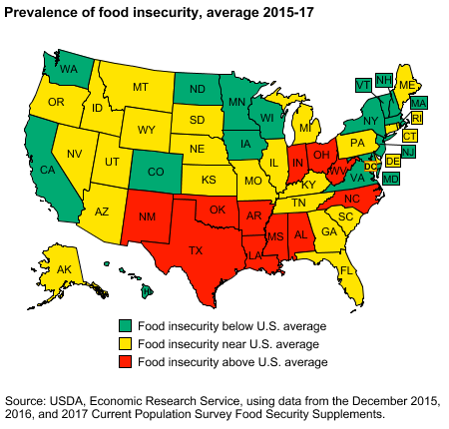

Slide 4
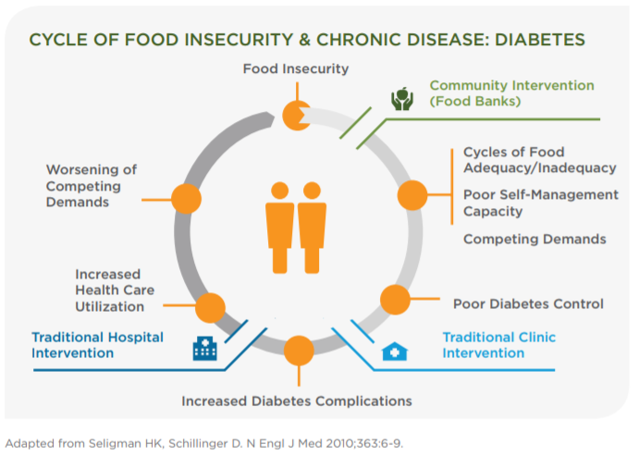
Relevance to Public Health
An underrecognized social determinant of health
Fruit and vegetable intake
Chronic disease management
Health care costs

Slide 5
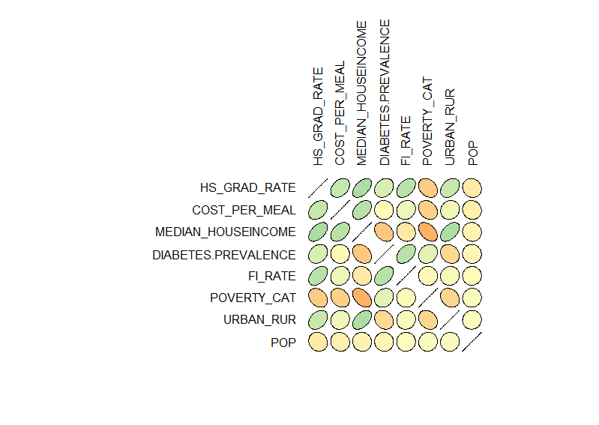
Correlation
Notes:
Because of the correlations, chose to include interaction for diabetse with meidan house income and urban_rural. Literature backs up that these are relevant things to look for.
Maybe have a footnote denoting the highest correlation.

Slide 6
Methodology
Got rid of % below poverty level predictors, dummy coded poverty categorical predictor, added interaction variable between diabetes/rural and diabetes/med house income.
Scaled predictors.
Ran stepwise, backwards, and best subset selection using AIC.
Added interaction (manually) and tested for constant variance, failed test.
Implemented weighted least squares.
Acquire final model with interaction, tested residual normality and checked for outliers.

Slide 7
Full Model
Food Insecurity = β0 + β1(Population) + β2(UR) + B3(Poverty_2) + β4(Poverty_3) + β5(Cost per Meal) + β6(MHI) + β7(Diabetes Rate) + β8(HS Graduation Rate) + β9(UR)(Diabetes Rate) + β10(MHI)(Diabetes Rate)
UR: Urban = 1, Rural = 0.
Poverty_2: Majority in poverty are 165-180% under poverty level = 1, otherwise 0
Poverty_3: Majority in poverty are 180% under poverty level = 1, otherwise 0
Interaction between UR with Diabetes Rate, and MHI with Diabetes Rate has been reported in literature.

Slide 8
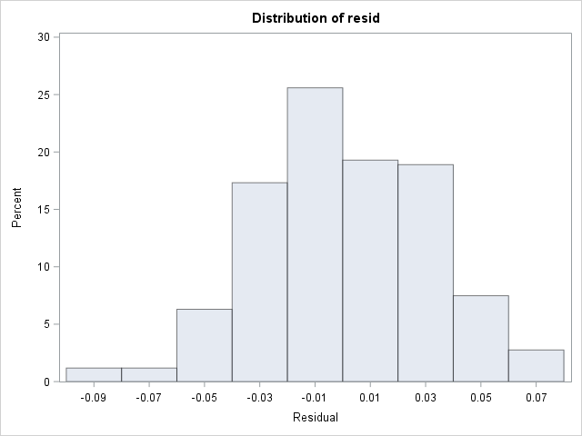

Assumptions: Normality of Residuals Full Model

Slide 9
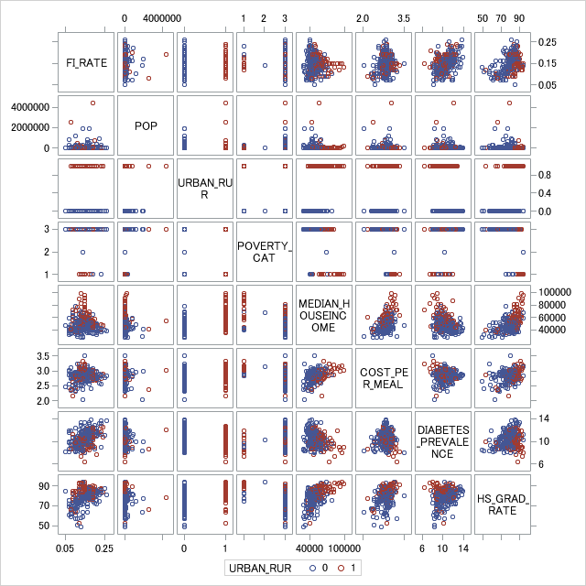
Assumptions: Linearity
Full Model
Linearity with FI Rate is met well for cost per meal and diabetes prevalence
Tested adding squared terms for median household income and high school graduation rate, but F-tests found that these additions did not improve the model.

Slide 10
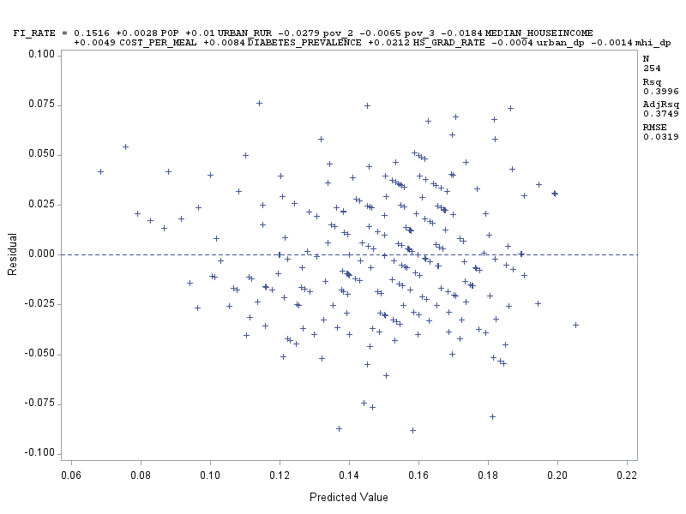
Assumptions: Homoscedasticity Full Model
Breusch-Pagan was non-significant with
Chi-square = 17.77, p = 0.059.

Slide 11
Variable Selection
Methods Used:
Stepwise selection (SLE = 0.1, SLS = 0.15)
Backward selection
Best subset selection using AIC
All 3 methods chose the same 5 predictors: urban/rural, high school graduation rate, median house income, cost per meal, and diabetes prevalence.
Due to previous research, chose to keep interaction of diabetes and urban/rural status and interaction of diabetes and median household income in the model.

Slide 12
Final Model
Food Insecurity = β0 + β1(UR) + β2(Cost per Meal) + β3(MHI) + β4(Diabetes Rate) + β5(HS Graduation Rate) + β6(UR)(Diabetes Rate) + β7(MHI)(Diabetes Rate)
UR: Urban = 1, Rural = 0.

Slide 13
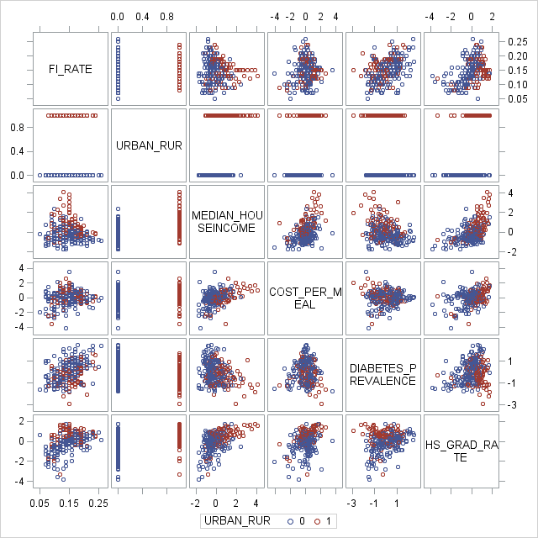
Assumptions: Linearity Final Model
Check whether squaring median house income or high school graduation rate will help improve the model.
F-test did not find this to be the case.

Slide 14
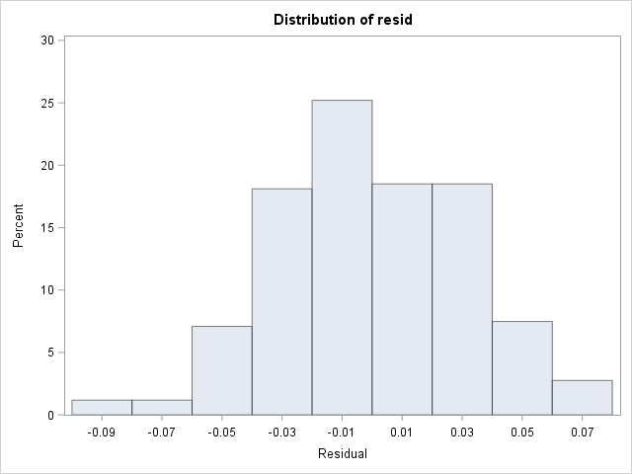

Assumptions: Normality of Residuals Final Model

Slide 15
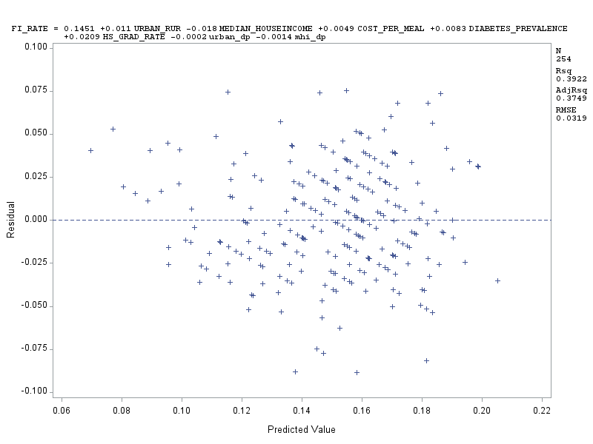
Assumptions: Homoscedasticity (Almost) Final Model
Breusch-Pagan test rejects null with Chi-square = 16.12, p < 0.05.
We must use weighted regression to account for heteroscedasticity.

Slide 16
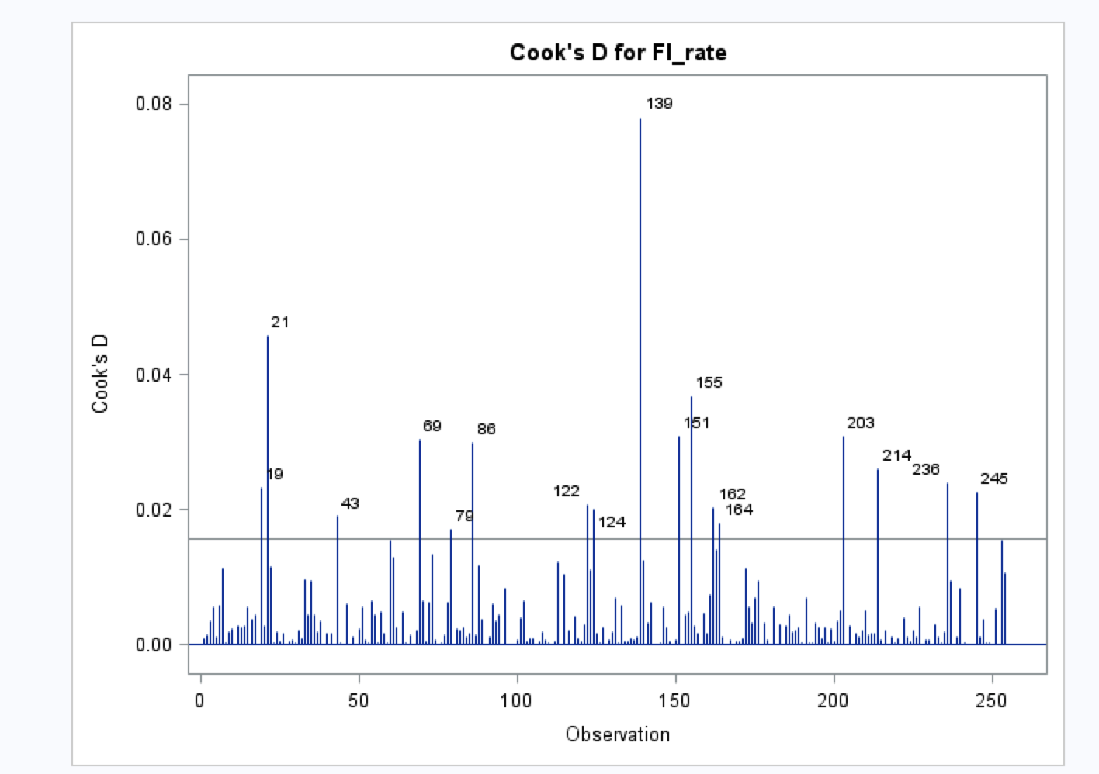
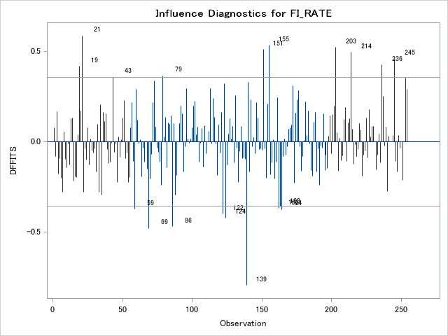
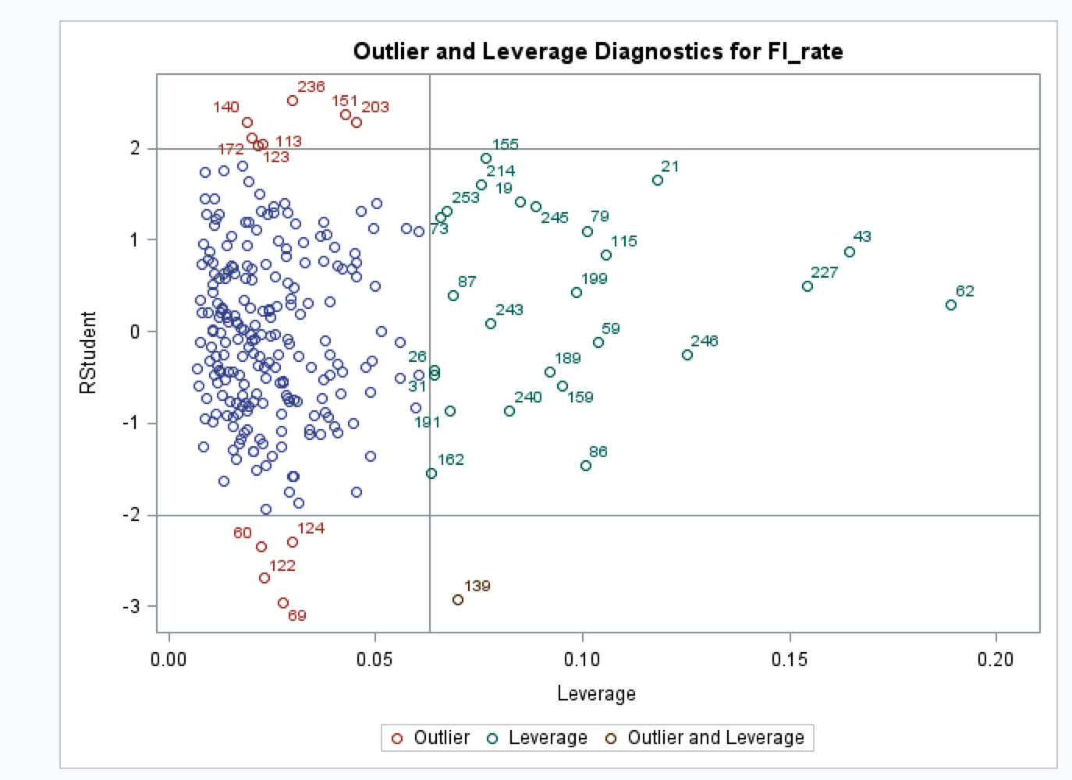
Outliers and Leverage
There were no outliers according to Cook’s distance
There were also no points with strong influence, as none have a DFFITS value over 1
Leverage points are < 0.2
Notes:
The plot looks like a mess on my version of SAS. Code is taken from the lecture, please feel free to run it using our updated Full Model.
proc reg data = Mealgap1; /*change to your table name*/
model FI = pop poverty1 poverty3 mcost MHI diabetes HSgrad UR /influence; /*update with interactions*/
output out = influencestats cookd=cooksd dffits=dffits h=hatmat p=preds r=resid rstudent=studdelresid student=studres;
run;
data influencestats;
set influencestats;
tvalue = tinv(0.9975,16);
if (abs(studdelresid)) gt tvalue then outliery=1; /*if the absolute value of studentized deleted residual is greater than tvalue, set outliery = 1 */
if (abs(studdelresid)) le tvalue then outliery=0; /*if not then set outlier =0*/
Run;
/*you shouldn't get any output here, since we don't have outliers*/
proc print data = influencestats;
where outliery=1; /*only perform this proc on the lines where outliery=1*/
var id;
run;
/*For Cooks distance plot*/
data influencestats;
set influencestats;
fval=finv(0.5,3,17);/*this computes the threshold for cooks d*/
run;
goptions reset = all;
axis1 label=(a=90);
symbol pointlabel=('#id' c=black h=1) value=none;
title "plot of cook's distance with reference f(p,n-p) percentile =0.50";
proc gplot data = influencestats;
plot cooksd*id /vref = 0.8212 vaxis=axis1 lvref=2; /*0.8212 is from the fval above*/
run;

Slide 17
Variable | Parameter Estimate | Standard Error | t-value | Pr>|t|
Urban/Rural status | 0.00983 | 0.00532 | 1.85 | 0.0659
Median Household income | -0.0147 | 0.00312 | -4.71 | <0.0001
Cost Per Meal | 0.00469 | 0.00209 | 2.25 | 0.0255
Prevalence of Diabetes | 0.00974 | 0.00315 | 3.09 | 0.0022
High School Graduation Rate | 0.01745 | 0.00249 | 7.00 | <0.0001
Rural Status*Diabetes | -0.00408 | 0.0604 | -0.67 | 0.5006
Median Household Income*Diabetes | 0.00131 | 0.0249 | 0.53 | 0.5999
Reference category is Rural
R-square no longer interpretable
Overall model is significant
Notes:
Maybe in our final report we can compare standardized predictors to see which predictor has the greatest influence on FI.

Slide 18
Validation
Unlike previous literature, we did not find that diabetes, urban status, or median income had interacted with one another to have an effect on food insecurity
The positive correlation between high school graduation rate and food insecurity in our model contradicts literary reports of a negative correlation.
Likely due to confounding variables and hidden interactions, rather than Texas being a special case.
Remaining predictors are consistent with published findings.
Notes:
Higher food insecurity is expected to result in lower high school graduation rates.
http://www.childrenshealthwatch.org/wp-content/uploads/FeedingHumanCapital_report.pdf

Slide 19
Discussion
Our model includes predictors which could be addressed through social policies.
Similar study by Feeding America also incorporated ethnicity and unemployment.
Their model is more accurate at predicting but not so much inferring the underlying factors affecting food insecurity.
Our model was consistent with expectations, with the exception of high school graduation rate.
Improving our model:
Consider unemployment rate
Consider % poverty rate
Validating our model in other states, find potentially significant predictors.

